Slide 1


ISL-based Multi-Satellite Collaborative
Computation Offloading and Resource Allocation in ISTN
汇报人：张玉洁
2024年5月13日

Slide 2



CONTENT
01
02
Research Motivation
System Model
03
04
MSCCORA-TD3 Algorithm
Performance Evaluation
2

Slide 3

PART 1
Research Motivation
3

Slide 4
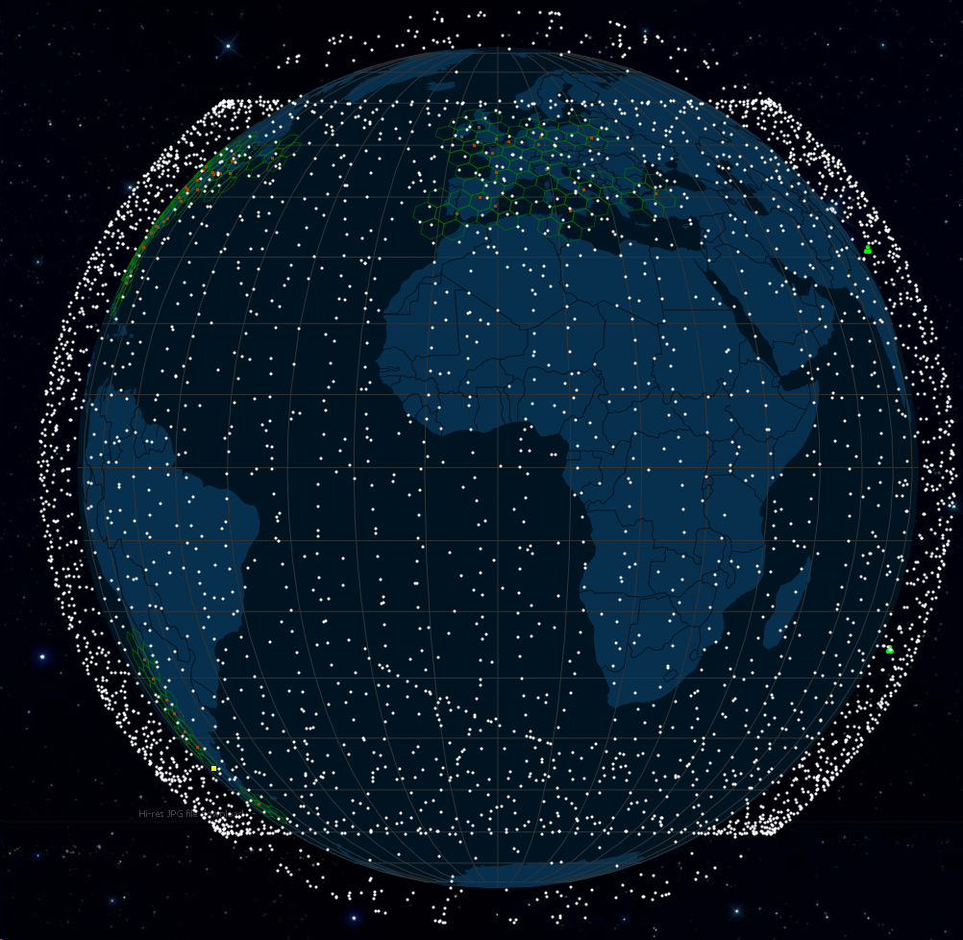
1.1
Research Background
ISTNs is the future trend of development
LEO satellite network can achieve seamless coverage
LEO satellite network possesses several distinct advantages, such as low propagation delay, reduced link loss, and broad coverage areas.
LEO satellite network is anticipated to integrate with terrestrial networks, facilitating seamless coverage across all regions.
ISTNs is a national strategic need
In "The 14th Five-Year Plan for Economic and Social Development of the People's Republic of China and the Long-Range Objectives Through the Year 2035," it is explicitly stated that "we must build high-speed, ubiquitous, integrated, interconnected, secure, and efficient information infrastructure that integrates space and earth."
Starlink LEO satellite constellation

Slide 5
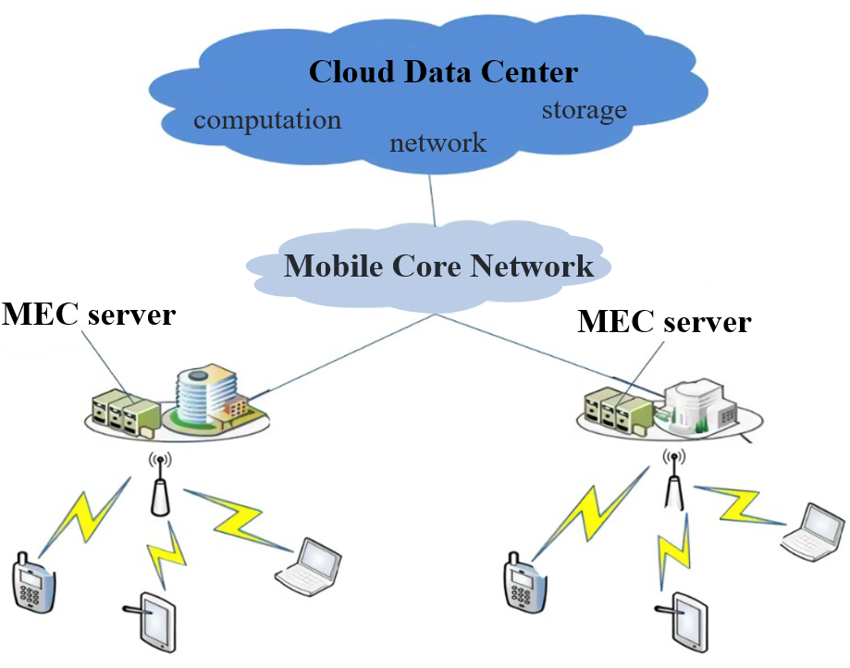

1.1
Research Background
The OEC paradigm extends the computing platform to LEO satellite networks, providing computational support for ground users
MEC paradigm
MEC paradigm effectively reduces service latency and enhances data processing speeds by deploying computational resources and services at the network edge.
MEC alleviates the load on traditional central cloud centers, optimizes network bandwidth utilization, reduces energy consumption, and improves the overall network efficiency.
ISTNs equipped with satellite edge servers
Incorporating the OEC paradigm ISTNs can simultaneously address the emerging demands for coverage and computational power. This enables seamless, low-latency computing services with global coverage for terrestrial users.
MEC architecture

Slide 6
1.2
Research status
Using LEO satellites as a relay to expand the coverage area
High latency
multi-satellite collaborative computation offloading and resource allocation problem in the ISTNs
High latency
Using traditional algorithms for offloading decisions and resource allocation
High algorithmic complexity
Wireless channel environment dynamically changes and tasks arrive randomly
Inability to adapt to dynamically changing network environments
Characterize the latency of different tasks and meet the latency constraints of the tasks
Consideration of computation offloading and resource allocation issues under a single satellite scenario
Single satellite overload
The multi-satellite collaboration leads to an increase in the dimensions of the action space and state space
Low resource utilization rate

Slide 7
1.3
References
[1] S. Zhang, G. Cui, Y . Long, and W. Wang, “Joint computing and communication resource allocation for satellite communication networks with edge computing,” China Communications, vol. 18, no. 7, pp. 236– 252, 2021.
[2] Z. Song, Y . Hao, Y . Liu, and X. Sun, “Energy-efficient multiaccess edge computing for terrestrial-satellite internet of things,” IEEE Internet of Things Journal, vol. 8, no. 18, pp. 14 202–14 218, 2021.
[3] Q. Tang, Z. Fei, B. Li, and Z. Han, “Computation offloading in leo satellite networks with hybrid cloud and edge computing,” IEEE Internet of Things Journal, vol. 8, no. 11, pp. 9164–9176, 2021.
[4] X. Cao, B. Yang, Y . Shen, C. Y uen, Y . Zhang, Z. Han, H. V . Poor,and L. Hanzo, “Edge-assisted multi-layer offloading optimization of leo satellite-terrestrial integrated networks,” IEEE Journal on Selected Areas in Communications, vol. 41, no. 2, pp. 381–398, 2022.
[5] Q. Tang, Z. Fei, B. Li, H. Y u, Q. Cui, J. Zhang, and Z. Han, “Stochastic computation offloading for leo satellite edge computing networks: A learning-based approach,” IEEE Internet of Things Journal, 2023.

Slide 8
PART 2
System Model
2

Slide 9
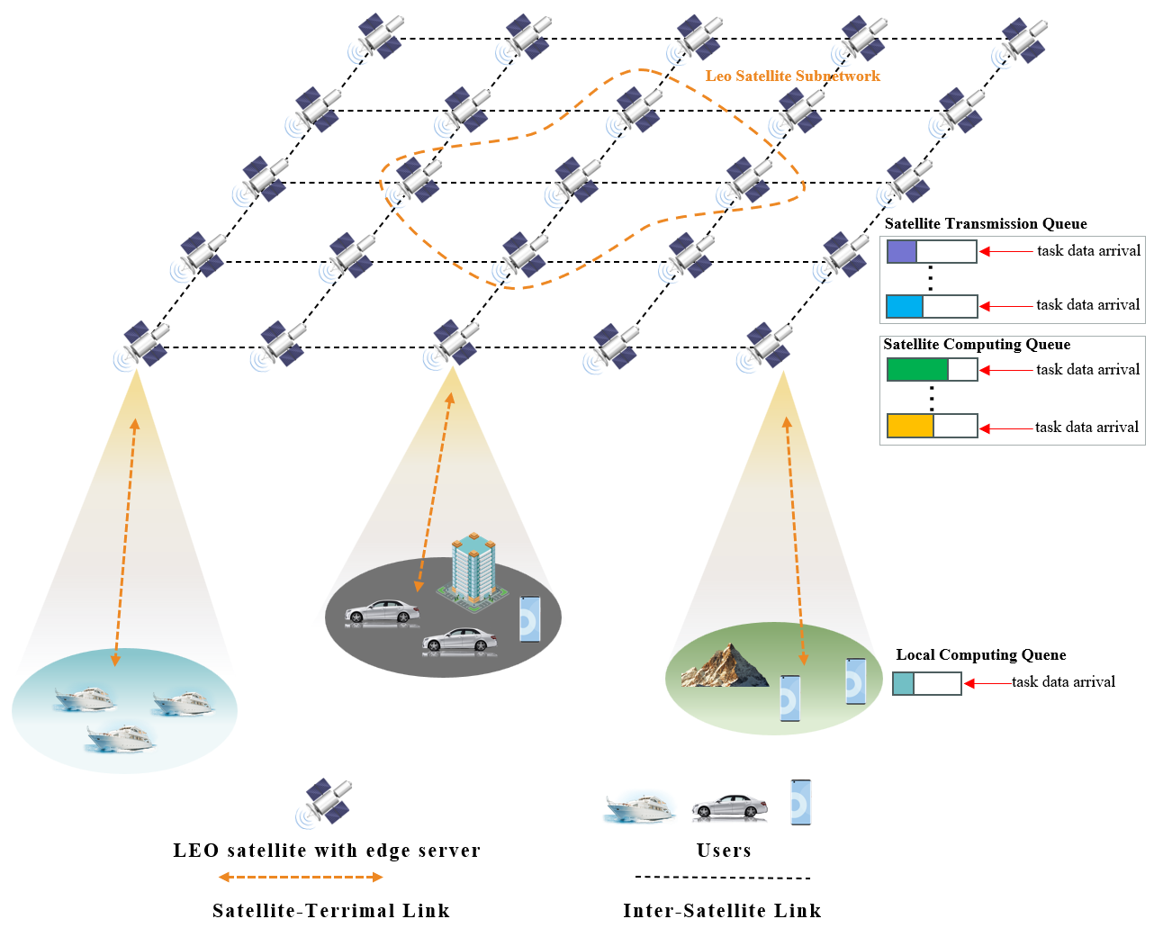
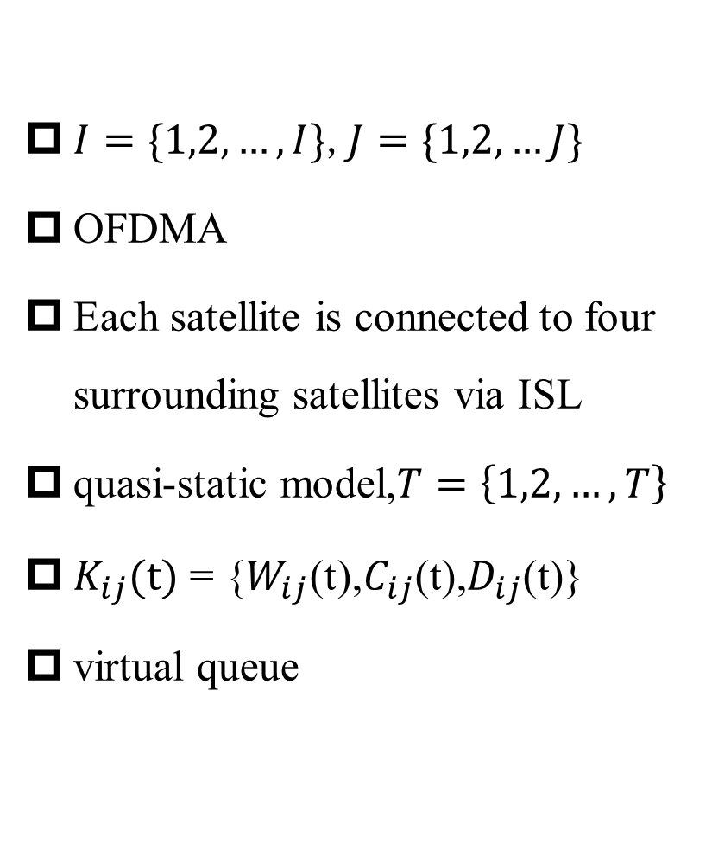
2.1
Network Model
$I=\{1,2,…,I\}$,$J=\{1,2,…J\}$
OFDMA
Each satellite is connected to four surrounding satellites via ISL
quasi-static model,$T=\left\{1,2,…,T\right\}$
$K_{ij}(t)$ = {$W_{ij}$(t),$C_{ij}$(t),$D_{ij}$(t)}
virtual queue
The architecture of ISL-based collaborative OEC system

Slide 10
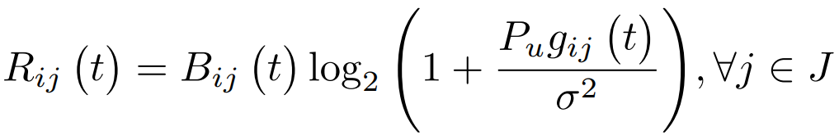
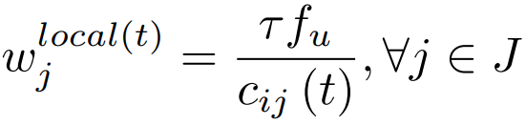
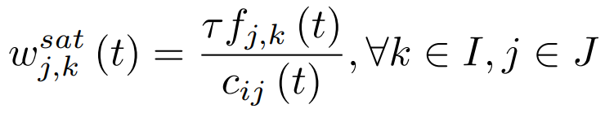
2.2
Communication & Computation Model
Satellite-Terrestrial Communication Model:
At time slot t, the uplink data transmission rate from user j to satellite i is denoted as
Local Computation Model:
During time slot t, the number of bits computed locally by user j is denoted as
LEO Edge Computation Model:
During time slot t, the number of bits that can be computed at satellite k for user j is given as

Slide 11
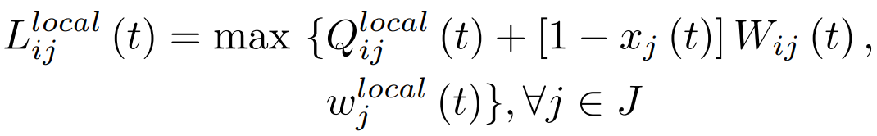
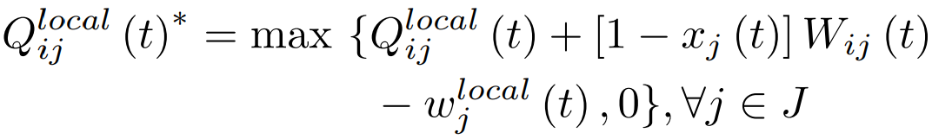
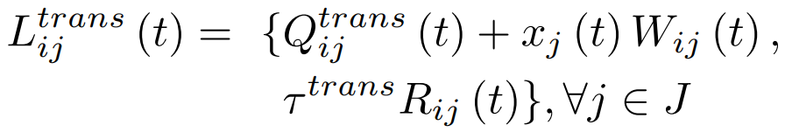
2.3
Queue Model
Local Computation Queue Update Model:
During time slot t , the number of task bits computed locally by user j is denoted as
After time slot t, the local computation queue is updated to
Satellite Transmission Queue Update Model:
During time slot t,the number of task bits transmitted by user j is denoted as

Slide 12
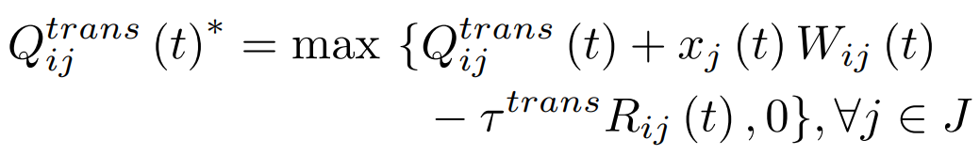
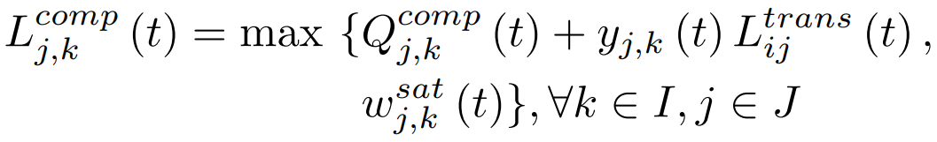
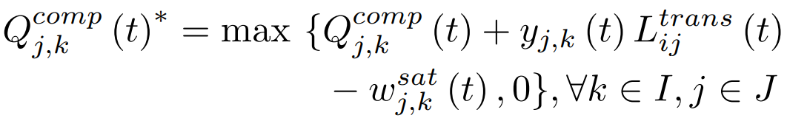
2.3
Queue Model
After time slot t, the user sub-queue in the satellite transmission queue is updated to
Satellite Computation Queue Update Model :
During time slot t, the number of task bits computed by the satellite for user j is represented as
After time slot t, the user sub-queue in the satellite computation queue is updated to

Slide 13
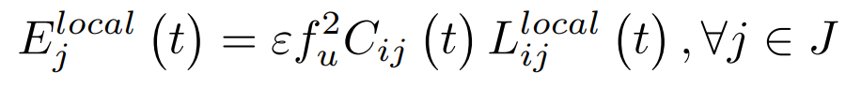
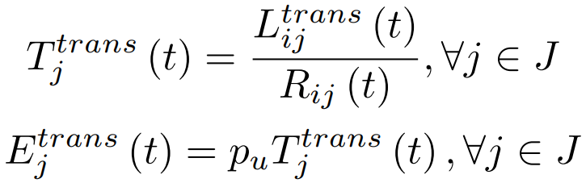
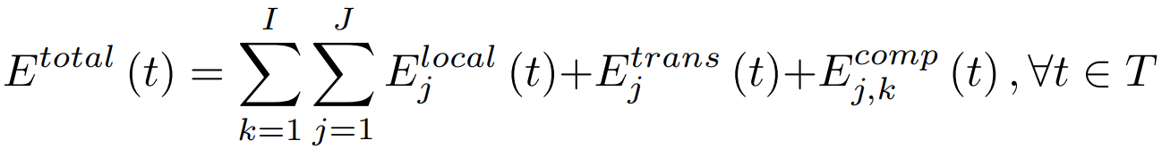
2.4
Energy Model
Local Energy Consumption Model:
In time slot t, the energy consumption for the task calculated locally by user j is represented as
Satellite Energy Consumption Model:
The transmission delay and energy consumption are denoted as
The calculated energy consumption of satellite k is expressed as
Satellite Energy Consumption Model:

Slide 14
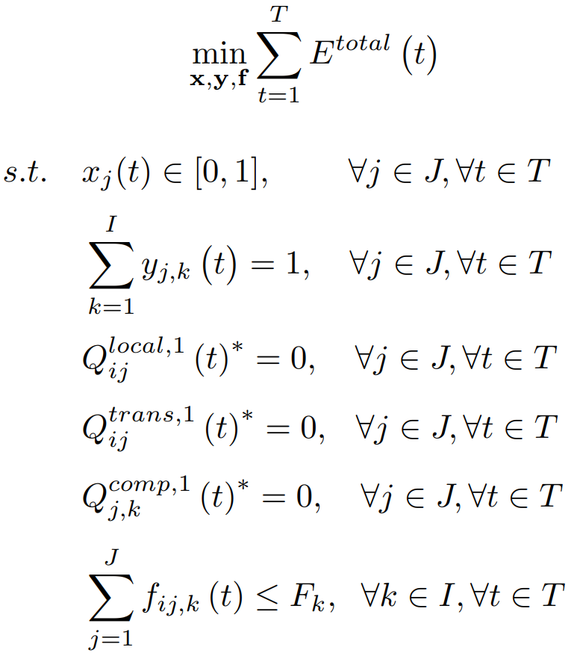
2.5
Problem formulation
This paper proposes an optimization problem, aiming to minimize the total energy consumption of the system to the greatest extent under the constraints of task delay and limited satellite resources. The objective function of the optimization problem is constructed as follows

Slide 15
PART 3
MSCCORA-TD3
Algorithm
2

Slide 16
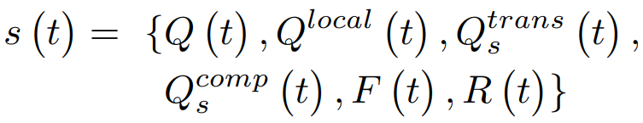
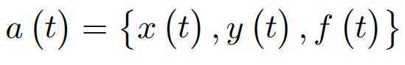
2.1
Modeling the problem as a MDP
This dynamic offloading problem can be constructed as a MDP. The elements in this MDP are denoted as:
State Space:
Action Space:
Reward Function:

Slide 17
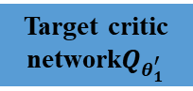
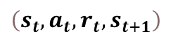
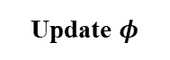
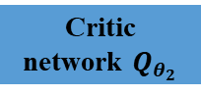

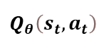
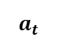
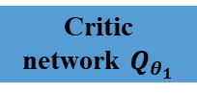
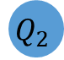
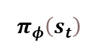
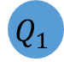
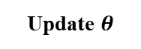
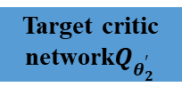
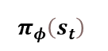
2.2
Algorithm framework
$$\left(s_{t},a_{t},r_{t},s_{t+1}\right)$$
Update
Update
TD-error
Random min-bacth sample
Policy Gradient Descent
Loss function
Update $θ$
Update $φ$
Experience replay buffer
Critic network $Q_{θ_{1}}$
$$Q_{1}$$
TD-error1
Actor network
$$Q_{θ}\left(s_{t},a_{t}\right)$$
Critic network $Q_{θ_{2}}$
$$Q_{2}$$
TD-error2
$$π_{φ}\left(s_{t}\right)$$
$$π_{φ}\left(s_{t}\right)$$
Soft-Update
Environment
$$a_{t}$$
Min
Target actor network
Target policy smoothing
Target critic network$Q_{θ_{1}^{′}}$
$$Q^{′}$$
Target critic network$Q_{θ_{2}^{′}}$
Random noise

Slide 18
PART 4
Performance
Evaluation
2

Slide 19
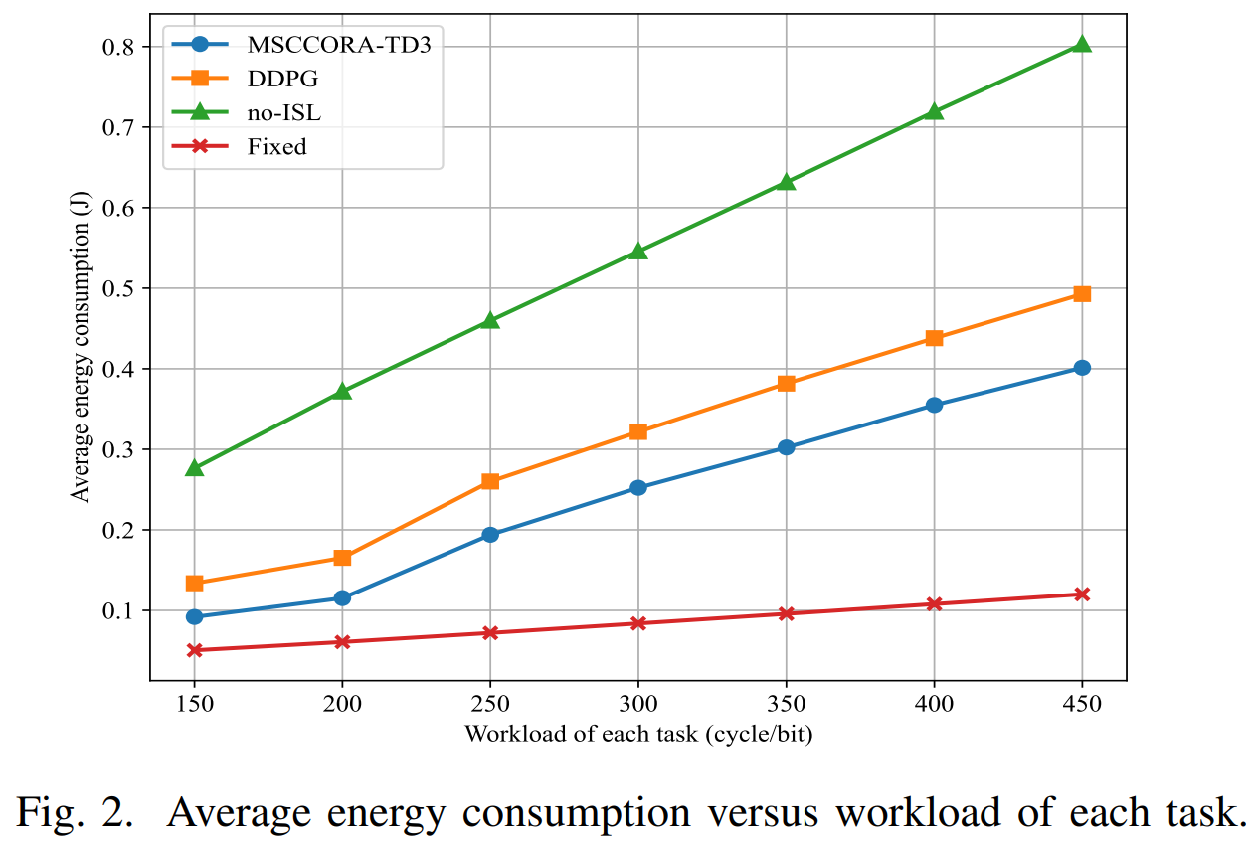
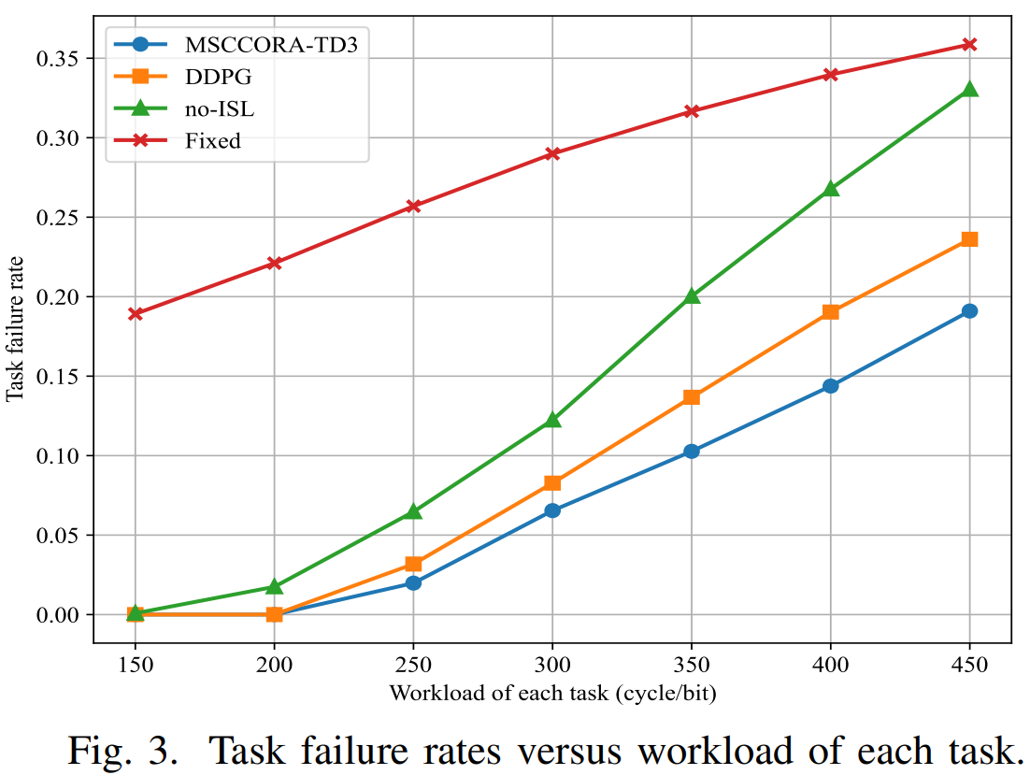
4.1
Evaluating System Performance with Variable Task Workloads
The local computing capacity of each user is set to 200MHz

Slide 20
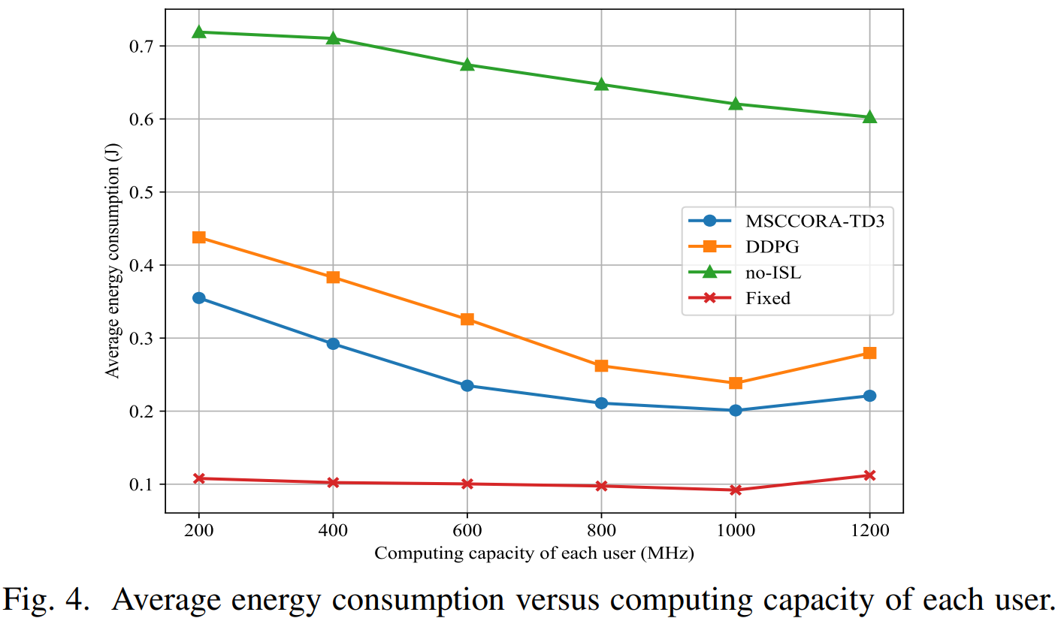
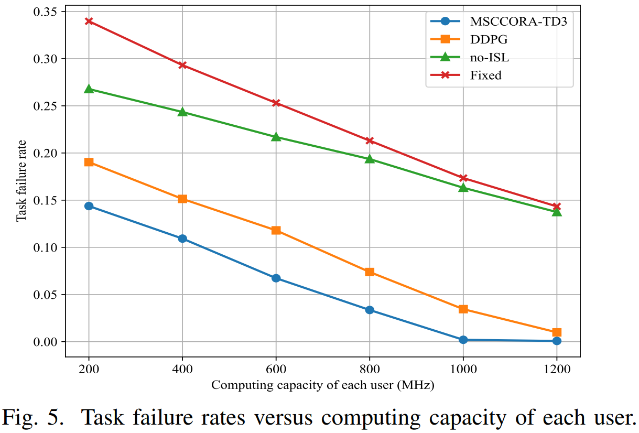
4.2
Evaluating System Performance with Variable Computing capacities
The workload of each task is set to 400 cycles/bit

Slide 21



QUESTIONS & ANSWERS

